Slide 1

Ground truth finding on Song Recommendation system
Group 4 – MIT & Great learning advanced data science bootcamp

Slide 2
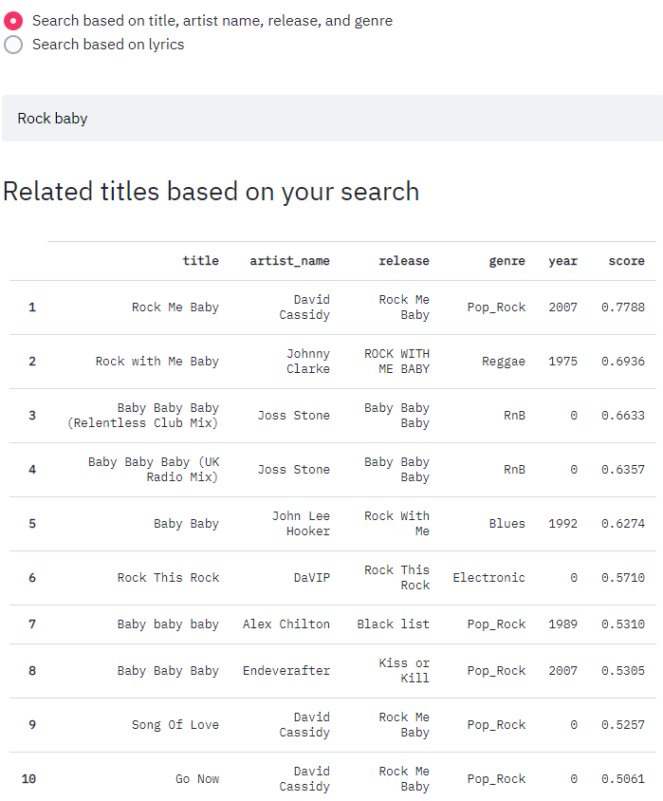
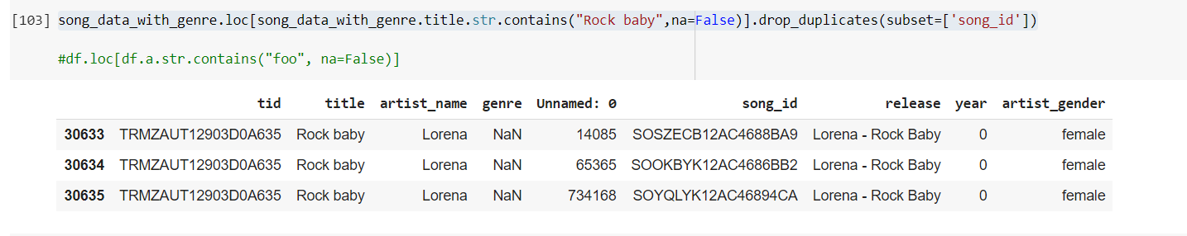
Case 1 – Searching from words in Title.
Searching from title can be different from searching in a combination of “ title, artist name, release, and genre”. User may want to search from title with few words which is on top of his head.
Searching from title
Content based search

Slide 3
Case 2 – searching from “title, artist name, release, and genre”
Using str.contains & str.match in text we are able to get the almost same results as content based filtering results for multiple observation.

Slide 4
Popularity as per the Artist Name along with Region
In the design we can introduce Artist name along with Region to slice popularity

Slide 5
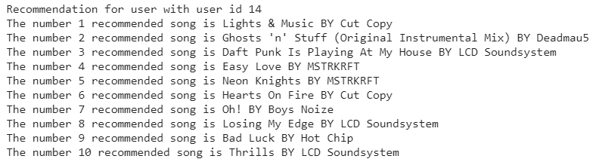
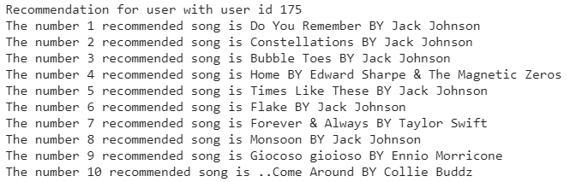
Case 3 – collaborative filtering with user recommendation
Finding song recommendation for a set of users.
Sample user’s set used :-
Sample recommendation for each user in the set :-

